Slide 1
Work sheet results #1. Ecological awareness

Slide 2
Give 3 causes, which may encourage to use the alternative energy.

Slide 3
Give 5 alternative energy sources that you know.

Slide 4
What kind of energetics we should develop in Poland?

Slide 5
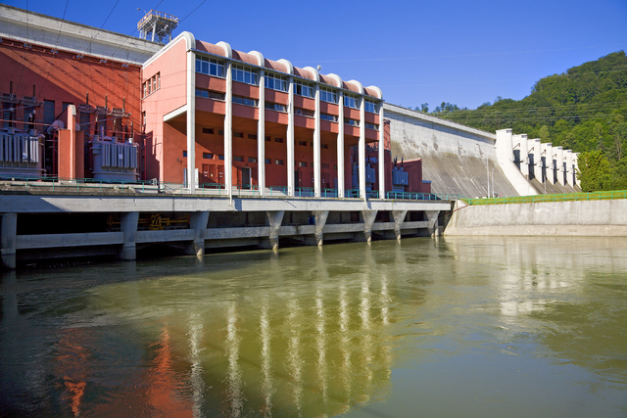
Students’ reasons – answers about choosing water energy
No pollution of natural habitat
It can be installed on small watercourses
Free material

Slide 6
Students’ reasons – answers about choosing wind energy
Prevent the global warming
High wind frequency in Poland
Cheap investment

Slide 7
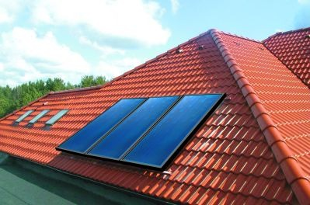
Students’ reasons – answers about choosing sun energy
Profitablity
Inexhaustible energy source
Low cost of solar panels montage

Slide 8
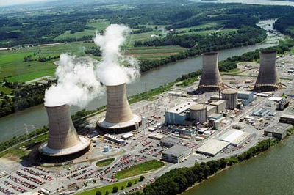
Students’ reasons – answers about choosing nuclear energy
Energetical safety
High performance
No air pollution

Slide 9
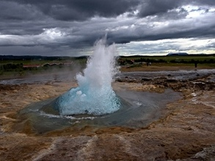
Students’ reasons – answers about choosing geothermal energy
Favorable habitat conditions
High temperature of Polish geothermal waters
Free material

Slide 10
What kind of energy can be used in your Town/ House?

Slide 11
Reasons of selecting – Sun energy
possible montage on a roof
Easy montage
Savings in households
Low costs of investment
No air pollution

Slide 12
Reasons of selecting – Wind Energy
Good natural conditions in Silesia
Low cost of investment
Free energy source
Savings for community
No air pollution

