Slide 1
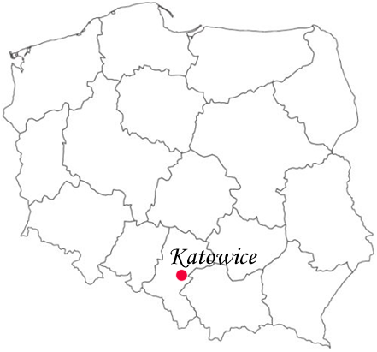
KATOWICE
Voivodeship – Silesian
President – Piotr Uszok
Area - 164.67 km²
Population - about 308 thousands
Katowice - is rather a big city in Silesia in southern Poland, on the Kłodnica and Rawa rivers.

Slide 2
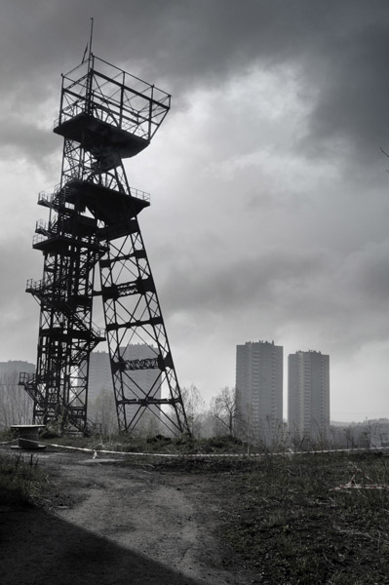
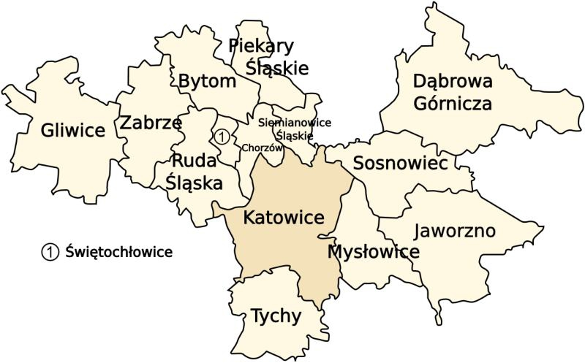
Is the largest agglomeration in Central and Eastern Europe.
Katowice is the center of science, culture, industry, business and transportation in southern Poland.
Shaft „Warszawa”
Katowice gained city status in 1865. Extensive city growth and prosperity depended on the coal mining and steel industries, which took off during the Industrial Revolution. This resulted in a rapid growth of many cities, including Katowice and Upper Silesian Industrial Region, which is one of the largest industrial regions of Europe. Katowice is the capital of the region today

Slide 3
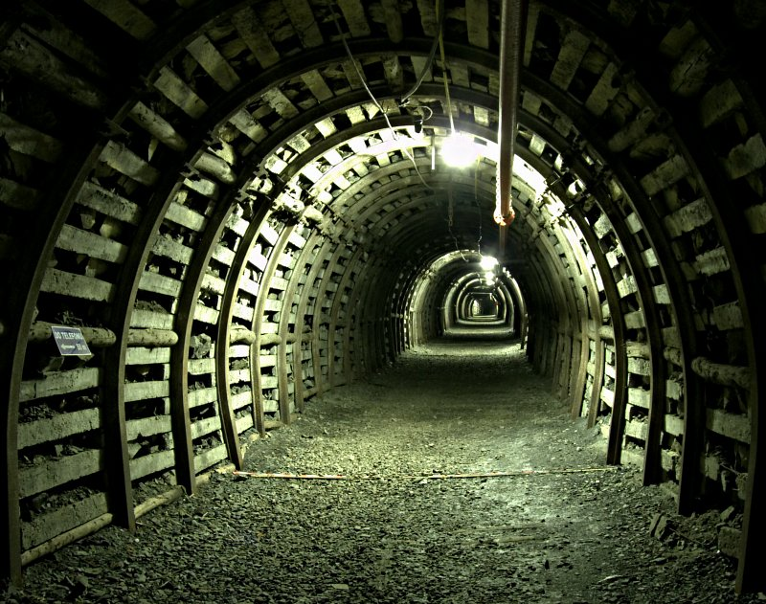
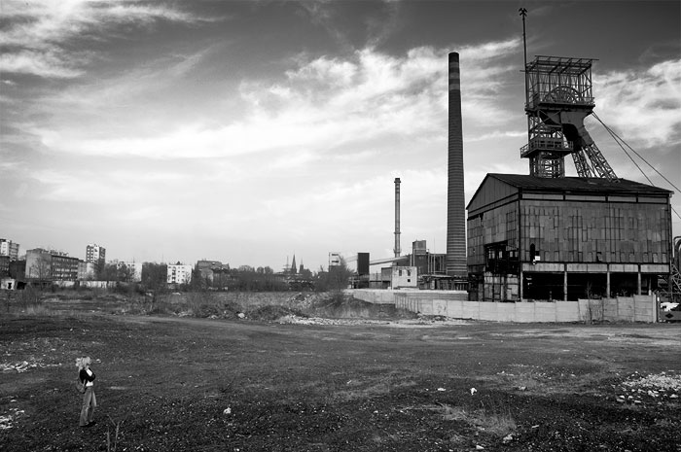
COAL MINES
Katowice is a large coal and steel center. It has several coal mines and one foundry of non-ferrous metals.

Slide 4
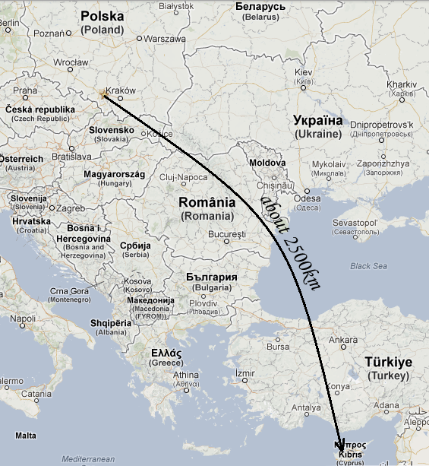
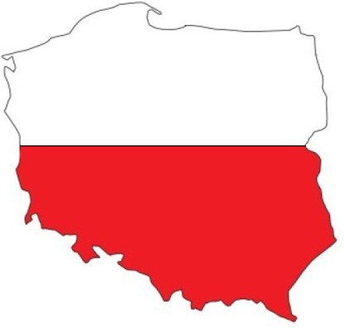
FROM KATOWICE TO CYPRUS
By plane: about 4h

Slide 5
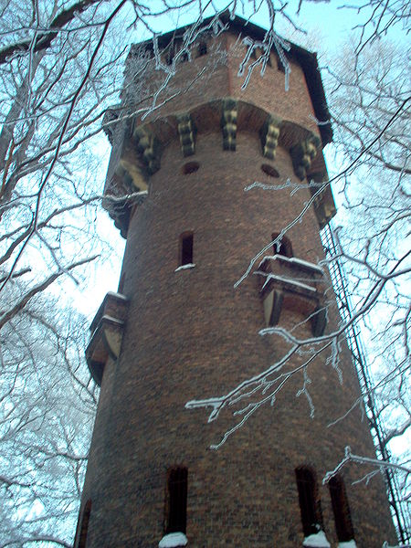
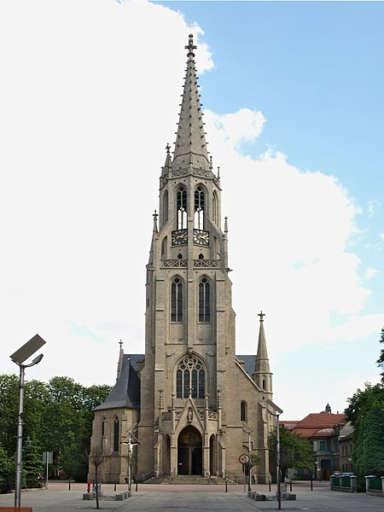
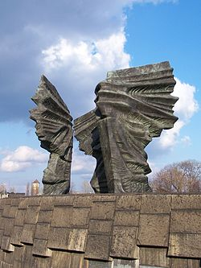
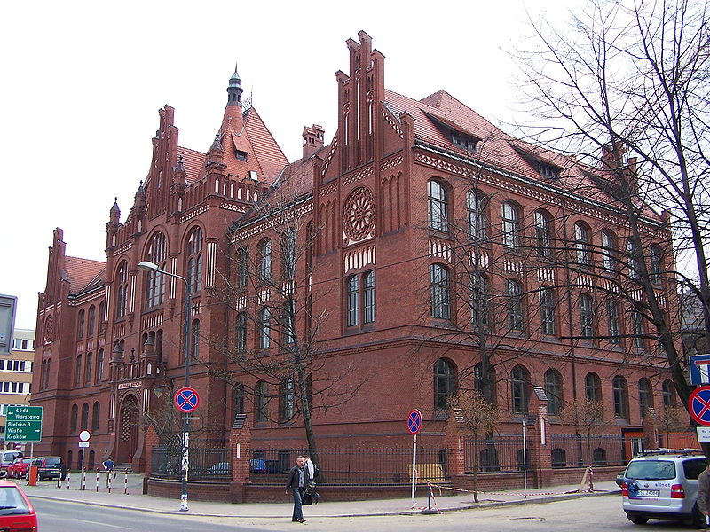
MONUMENTS
Monument of Silesian Insurgents
Tower in Giszowiec
St. Mary’s Church
Academy of Music

Slide 6
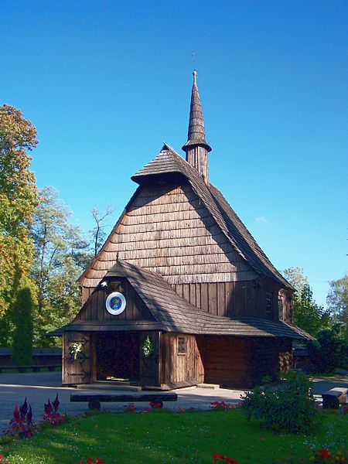
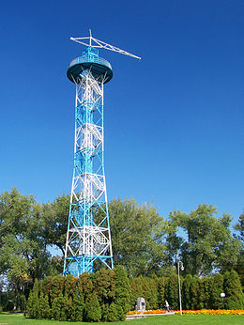
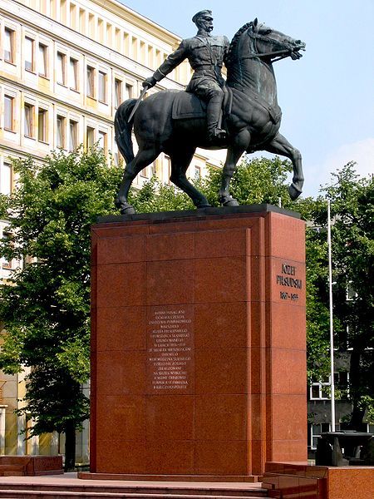
MONUMENTS
Józef Piłsudzki’s statue
St. Archangel Michael Church
In Tadeusz Kościuszko Park
Parachute Tower in
Tadeusz Kościuszko Park

Slide 7
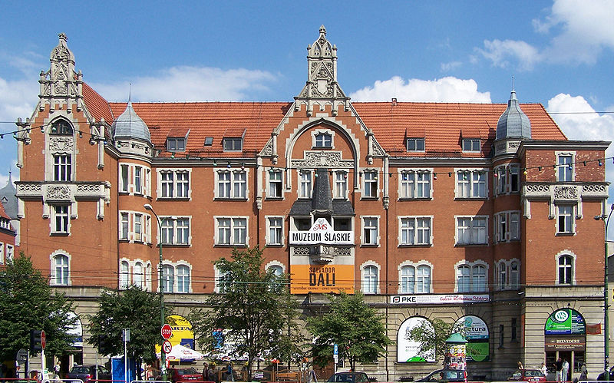
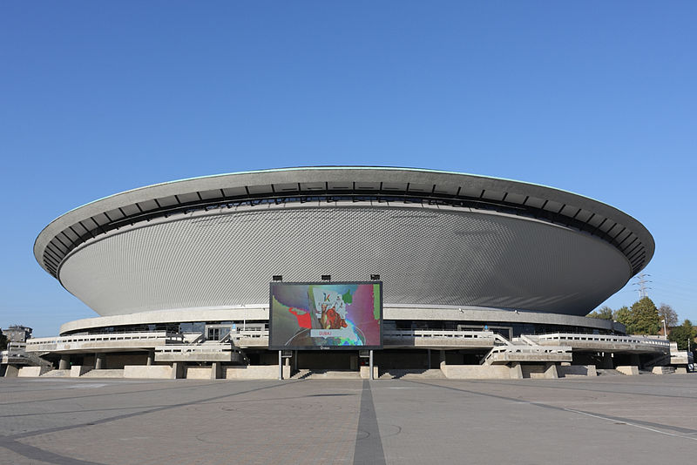
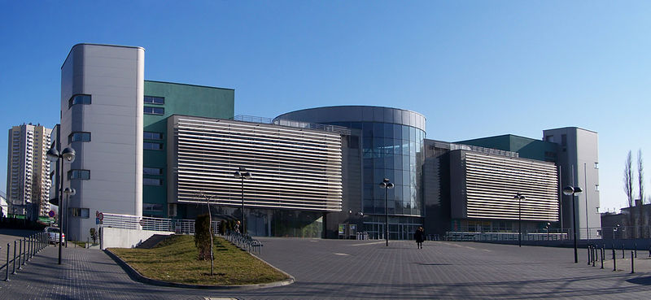
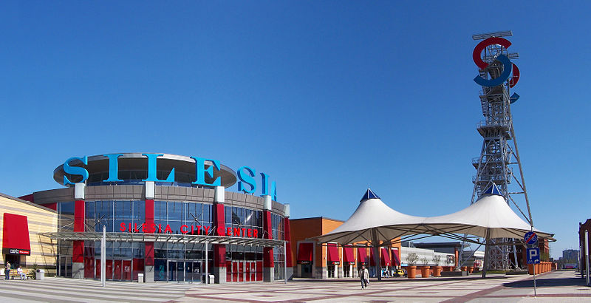
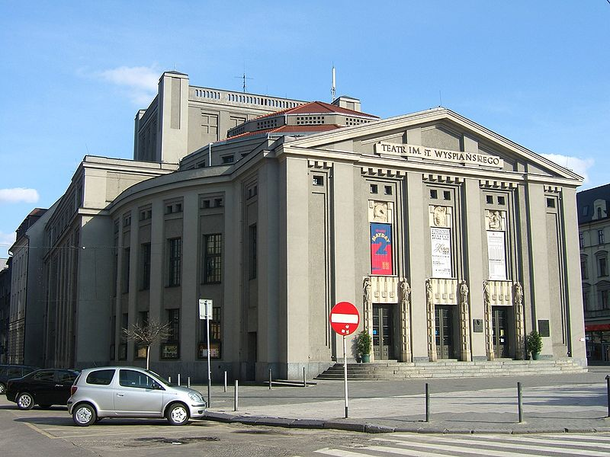
BUILDINGS
Silesian Museum
Spodek - multipurpose arena complex
University of Silesia
Faculty of Law and
Administration
Silesia City Center – shopping mall
Theater name
Stanisław Wyspiański

Slide 8
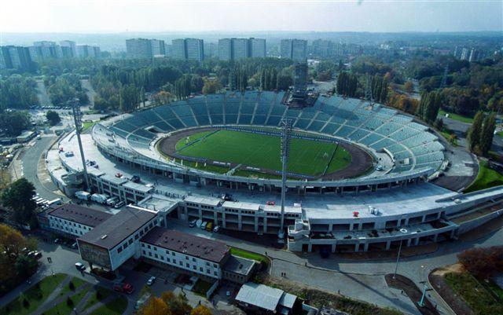
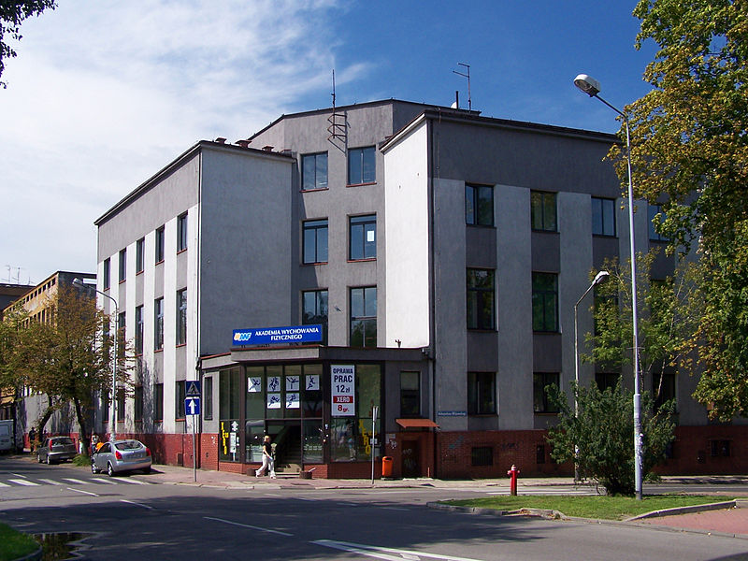
SPORT
This city has a long sporting tradition and hosted the highly successful international championships.
The Silesian Stadium
Academy of Physical Education

Slide 9
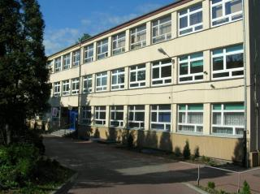
BIBLIOGRAPHY:
Our school
Winicjusz Nowak IIC
www.miasteria.pl
www.google.pl
www.wikipedia.org

