Slide 1
The questionnaire’s results. Solar energy

Slide 2
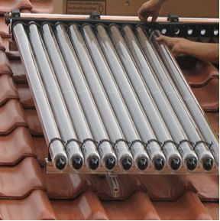
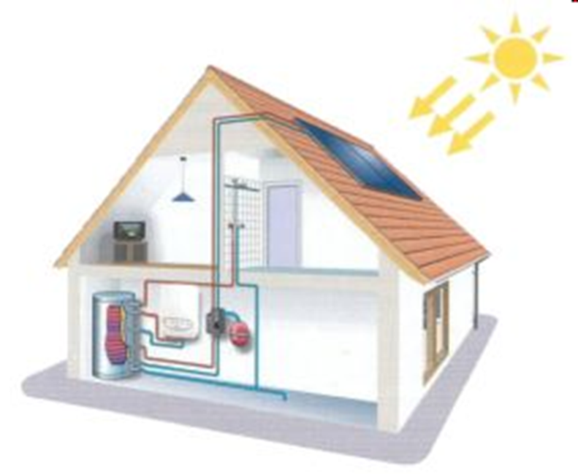
Give samples of using solar energy – the most common answers
Photovoltaic cells
Solar collectors to heat up the flats
Solar collectors to heat up water
Using solar energy in a very difficult to get places, where the power generator line is unprofitable

Slide 3
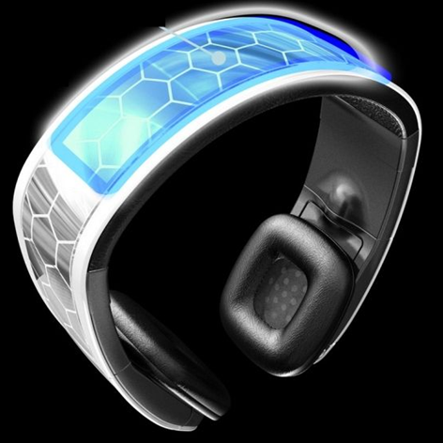
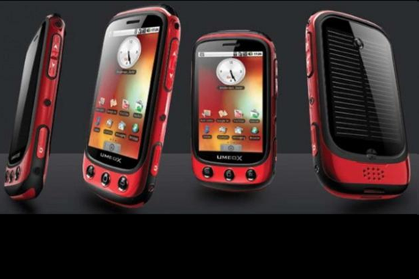
Give samples of using solar energy – the most common answers
Portable devices e.g. calculators, watches
Using photosynthesis to produce biomass
Using electric drive in e.g. vehicles
Devices that need a little power e.g. information tables, billboards

Slide 4
Give samples of using solar energy – the most common answers

Slide 5
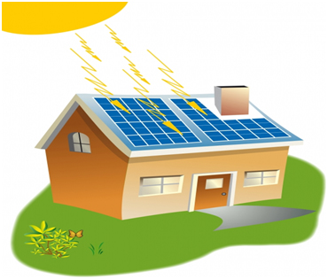
Give 3 advantages that can encourage you to use solar energy – The most common answers
Profitable for environment (pure energy)
Great possibilities to use this kind of energy in domestic devices and portable appliances
Installation of solar panells is not too expensive
Installation of panells is rather not complicated
The Sun shines for free
Inexhaustable energy source
Solar batteries can live long
The bills are lower
In Poland you can get refund of the installation costs

Slide 6
Give 3 advantages that can encourage you to use solar energy – The most common answers

Slide 7
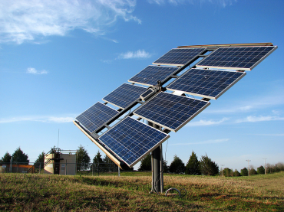
Give 3 disadvantages that can make the use of solar energy difficult for people – the most common answers
The amount of the energy depends on weather conditions
We don’t produce it at night
The costs of solar powerplants are high
There are difficulties to store the solar energy
The installation of solr cells takes a lot of place
To build these cells we use dangerous and harmful elements: selenium, arsenic, cadmium
The efficiency of solar batteries used in different appliances is not high

Slide 8
Give 3 disadvantages that can make the use of solar energy difficult for people – the most common answers

Slide 9
In your opinion should we invest in solar energy? Yes – 100% polled
Reasons:
Saving energy in households, gaining from different sources
Lower costs of energy usage
Decrease of air pollution, especially CO2 emission, because in Poland thermal energy dominates
Profits for environment, not only for Poland but also in a global scale

Slide 10
Do you use solar energy at home?

Slide 11
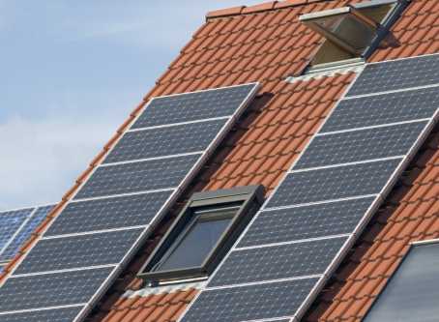
Do you know anybody who uses solar energy at home?

Slide 12
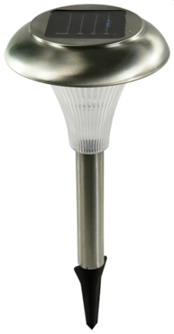
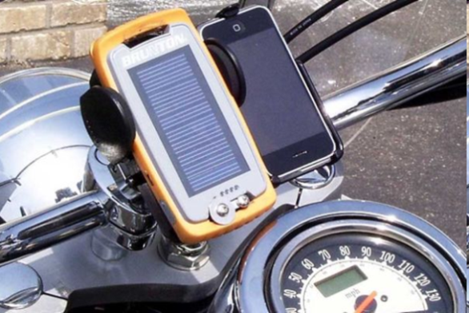
Give samples of using solar energy in your area
Solar panels on privat houses’ roofs
Heating up water by solar collectors
Using it in domestic devices
Using it to light e.g. street lamps
Using solar panels on companies’ roofs where parents work

Slide 13
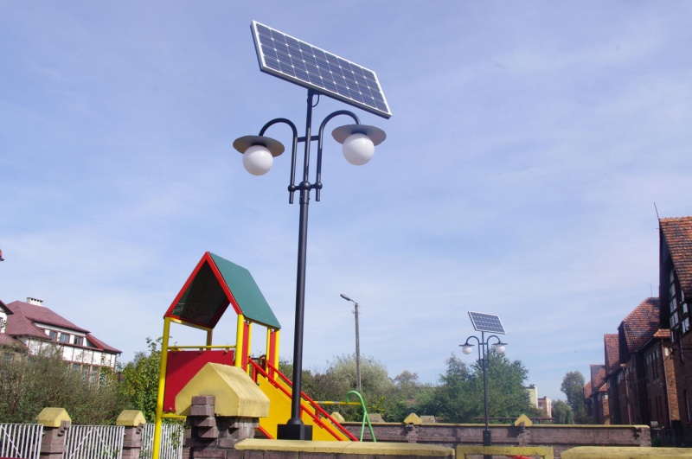
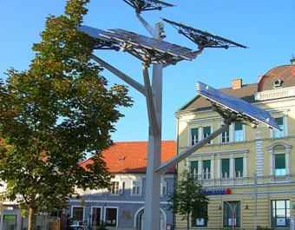
Give samples of using solar energy in your area
Lightning and information tables
Traffic lights near the bus stops
Using solar energy to produce biomass especially in the rural areas.

Slide 14
Give samples of using solar energy in your area

