Slide 1
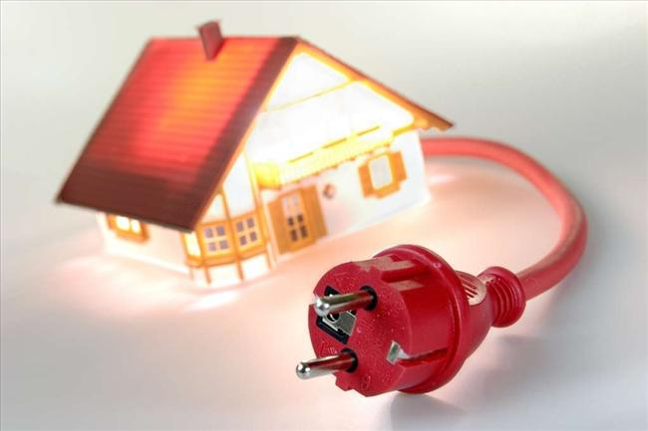
Results of Worksheet number 2. Energy in my house

Slide 2
The most used electric devices in our houses (5 most common answers)

Slide 3
Devices, which are permanently turned on (5 most common answers)

Slide 4
Devices, which we leave on standby (5 most common answers)

Slide 5
Devices, which we turn on only when we use them (5 most common answers)

Slide 6
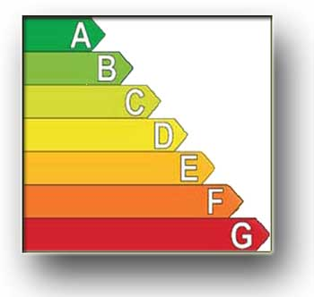
Energetic classes mostly used on electic devices.
Television – class A++ – 95%
Washing machine – class A – 80%
Fridge – class A+ – 90%
Iron – class B – 85%
Computer – class A+++ – 75%

Slide 7
Energy spendings in my home.
Average value of montly used energy ≈ 250 kW
Monthly price of used energy≈ 270 zł. (64 EUR)
Size of used energy per one person in a house ≈ 70 kW
Monthly price of used gas≈ 40 zł. (9,5 EUR)
Monthly cost of used thermal energy (refers to the winter season) ≈75 zł. (18 EUR)

Slide 8
Examples of actions, we use to save energy in our houses.
I turn off the light, when I leave the room
I turn off the phone charger, when battery is loaded
I use energy-saving bulbs
I do not leave my laptop or computer on standby
I turn off some devices for night
I buy devices with high energy-saving class
I turn off heating for night and when I leave house
I boil as much water that I need

