Slide 1

Solar
energy
in Poland

Slide 2
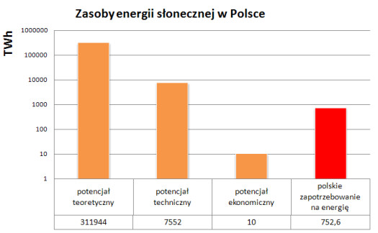
As natural resources of solar energy as other renewable resources of energy sources are divided into theoretical, technical and economical resources.
2008-2011 r.

Slide 3
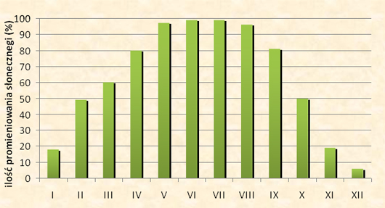
Solar energy resources in Poland show a big changeability all year round and even day and night.
The most solar energy reach the ground in June and July.
The magnitudes cross 150 kWh/ m2 a month.
In winter days are short so not much solar energy reaches the ground. The exposure to sunlight in December is only 25 kWh/m2.

Slide 4
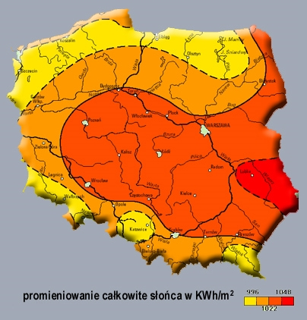
Exposure to sunlight in Poland
The most beneficial conditions in Poland to use solar energy has definately coastline.
Region of Podlasie is distinctive because of inflow of air from Ukraine
The least beneficial conditions are observed in mountainous region
(peculiar type of clouds), Suwałki, Warszawa and Upper Silesia (industrial air pollution).

Slide 5
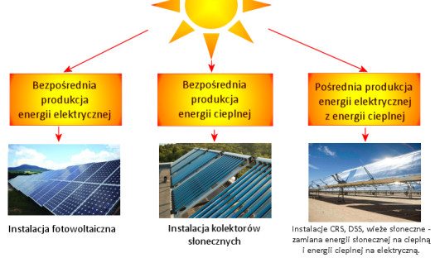
Ways of using solar energy
in Poland:
In Poland the most popular technologies that use solar energy are solar collectors because of low price.

Slide 6
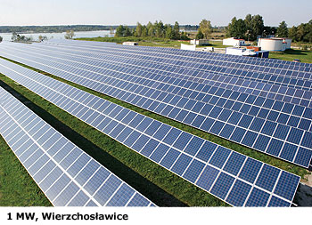
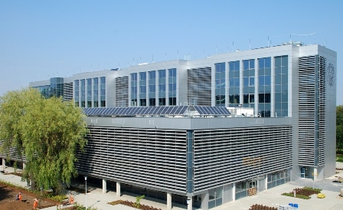
The list of photovoltaic systems in Poland
at power over 20 kWs:
Photovoltaic farm
in Wierzchosławice – 1,0 MW;
Upper Silesia Waterworks
in Ruda Śląska – 311 kW;
NG2 in Polkowice – 100 kW;
82 kW, Łódź, Specialist Hospital in Łódź – 82 kW;
Photovoltaic Centre by the Warsaw Politechnic – 54 kW;
Embassy of Japan in Warsaw – 20 kW.

Slide 7


According to Energy Department, the total power of photovoltaic cells in Poland at the end of 2011
was about 2 MW.

Slide 8
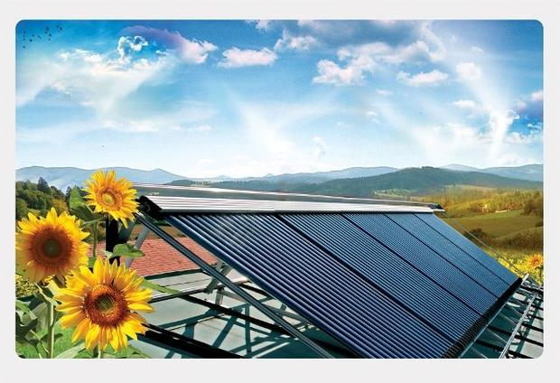
Thermal solar energy is one of the fast developing sectors of renewable energy in Poland and in EU; the avarage annual pace of growth in years of 2001-2012 was over 43%.
Because of this, Poland became the seventh solar energy market in EU. National manufacturers of solar collectors export over 50 % of these appliances abroad.

Slide 9

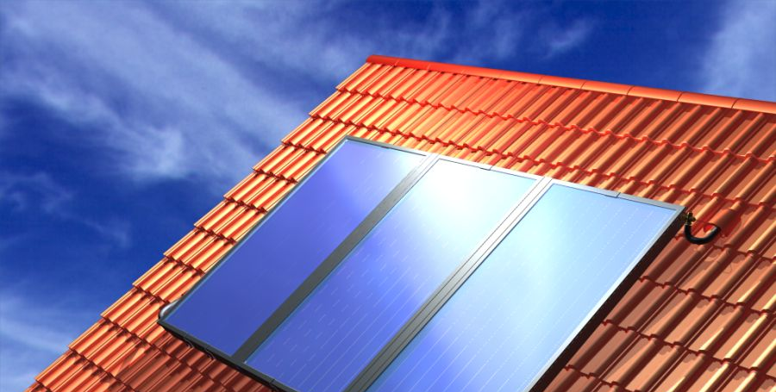
Manufacturers and distributors of solar systems in Poland:
ACV, Ariston, Biawar, Bachus, Caldoris, Domapol, Ecojura, Ensol, Hewalex, Immergas, Skorut, SolarPolska,
Solar-Tech, Solver, Stiebel Eltron, Suneko, Tehaco, Ulrich, Watt, Viessmann.
Currently in Poland there are 74 companies that produce and distribute solar collectors. According to IEO, on Polish market there are over 440 types of solar collectors.

Slide 10

Solar energy in Poland
- prospects
Solar energy definately can become a technology of future generations.
It happens thanks to innovative technologies that today allow to build projects on a grand scale.
By 2020 Poland will have to increase the usage of renewable energy sources up to 15% and reduce the emission CO2 by 20%
The solar energy development is entered in this strategy.

Slide 11
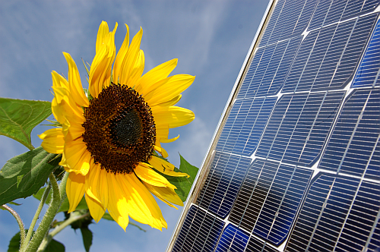
In Poland there is a possibility to get refund up to 45% to buy solar collectors, that is why, this investment became also viable for a client. The refund was introduced by National Fund of Environment Protection.
National Fund of Environment Protection allocated 300 million Polish zloty to carry out the program between 2010-2014. It will allow to instal
200 000 m2 of collectors.

Slide 12
Bibliography :
http://www.zielonecieplo.eu/serwis.php
http://www.enis.pl/energia-sloneczna.html
http://www.instalacje-solarne.com.pl/index.php?option=com_content&view=article&id=6&Itemid=10
http://ioze.pl/energetyka-sloneczna/zasoby-energii-slonecznej-w-polsce
http://www.oze.pl/energia-sloneczna/energia-sloneczna,9.html
http://www.komfort-international.com/pliki/file/Synteza%20wizji%20energetyki%20s%C5%82onecznej%20termicznej%20do%202020%20roku%20PL.pdf
own materials.

Slide 13
Weronika Biecka kl. II p

