Slide 1
Polish energy balance

Slide 2
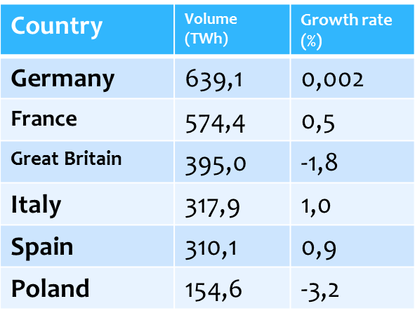
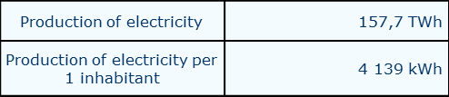
Annual energy production
Annual energy production in Poland is 154,6 TWh Poland is 6 energy producer in the European Union
The largest energy producers in the European Union

Slide 3
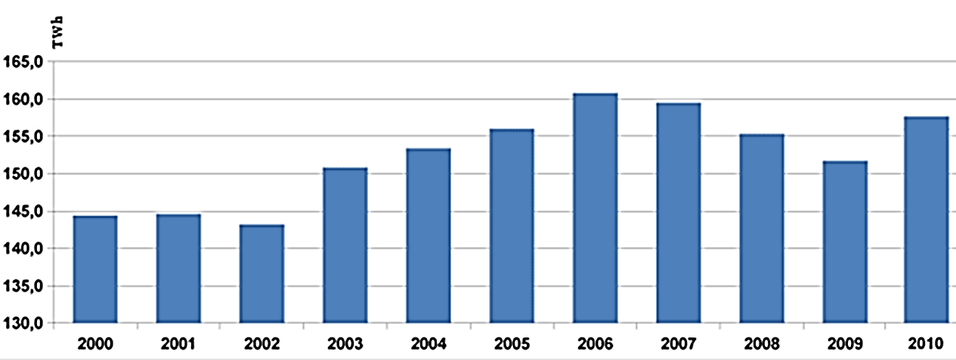
Annual electricity production [TWh]

Slide 4
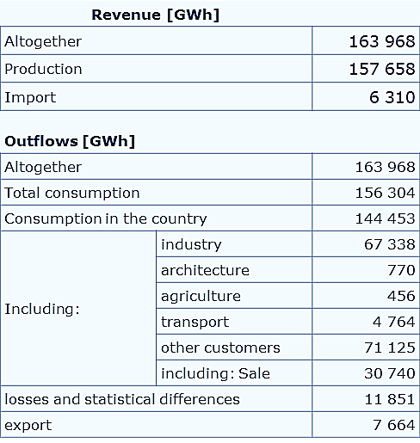
Import and Export

Slide 5
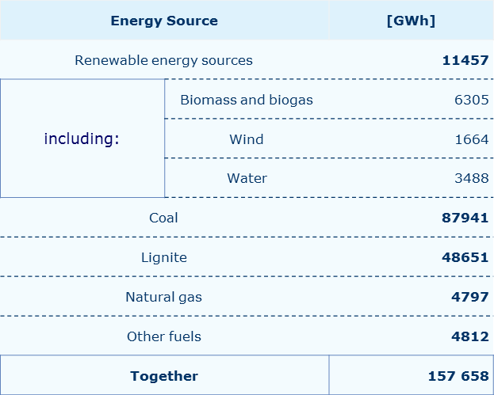
The structure of primary energy sources used to generate electricity in 2012

Slide 6
The percentage of each type of power energy

Slide 7
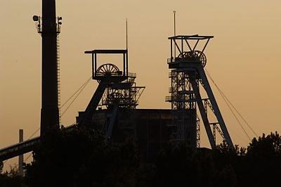
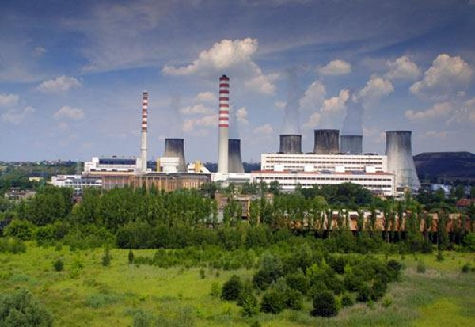
Over 62% of the energy produced from coal, and more than 32% of the coal. In Poland, the thermal energy dominates.
Coal mine KWK Bytom
Electric power plant in Łaziskach Górnych

Slide 8
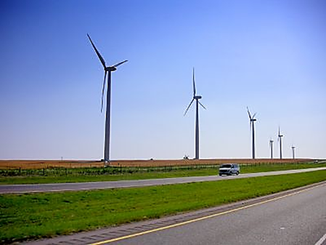
Polish energy in the future
In Poland, dominated by thermal energy, which produces a large amount of CO2. The result is that increasing the greenhouse effect and the ozone hole is growing. Our country must adapt to the rules of the European Union and reduce the emission of CO2 to a minimum, because in Poland should start with the development of wind energy, because we are good and favorable, as many as 70% of the country.
Wind turbines

Slide 9
Biography
http://www.ptpiree.pl/index.php?d=5&s=liczen_2010#ad4
http://www.enerad.pl/index/?id=6364d3f0f495b6ab9dcf8d3b5c6e0b01
http://www.czysta-energia.ovh.org/wiatr.html
http://www.ekogroup.info/6044/polskie-kopalnie-beda-mogly-liczyc-na-pomoc-publiczna/
http://www.rynekinfrastruktury.pl/artykul/index/art/11651/id/63
Search: www.google.pl

Slide 10
Performed:
Dominika Gajda and Monika Kaźmierczak
2c

