Slide 1
Solar energy
Inexhaustible source of energy

Slide 2

What is this solar energy?
Solar energy is the safest, the most inexhaustible and the biggest source of energy. The power of solar energy is 27*1.000.000.000 MW. Its advantage is also that it is the most ecological as well as free.
Although only half of the solar radiation comes to Earth, only two weeks is enough to have enough energy needed for all people throughout the year. The radiation that reaches the Earth is called direct radiation. Reflected and absorbed and later emited by particles of gases and dust is called diffused radiation. The sum of direct ad diffused radiotion is total solar radiation. If we add to it the reflected radiation coming in a particular unit of time we come up with insolation.
It can be used in an indirect and direct way. To make it in a direct way we need solar panels (getting thermal energy), solar cells (production of electricity), solar driers, cookers and ovens. We can use solar energy indirectly, for example in house building by caring about well thermoregulation. Its example may be putting large windows facing south.

Slide 3
Renewable energy in the EU - The share of renewable energy in total energy consumption in 2010.

Slide 4
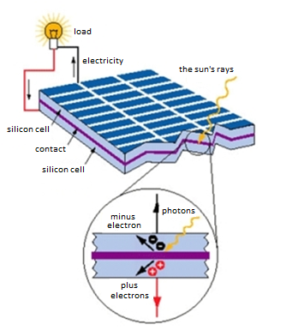
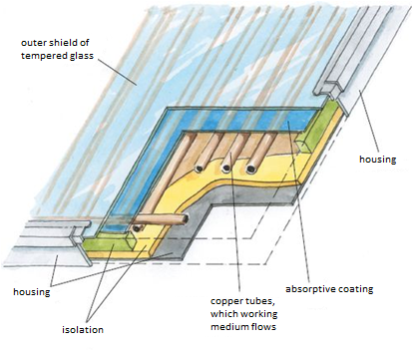
The use of solar energy
In Poland the most popular use of solar energy is the use of solar panels and photovoltaic cells.
Photovoltaic cell
Solar collector

Slide 5
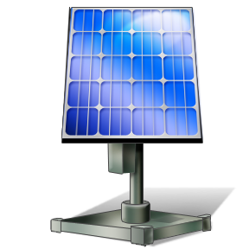
Theory and issues
Photovoltaics:
The field of science and technology dealing with converting solar radiation into electricity using photogalvaic phenomenon. This type of convertion of solar energy into the electricity belongs to so called renewable sources of energy. The advatange of this form of energy is: it is free and the sources practically never end.
What is the difference between photogalvaic modules and solar panels?
The answer is simple. Photogalvaic modules are used to produce electricity while solar panels are used to heat water.
Where do photogalvaic instalations may be insalled?
Everyone interested in photogalvaic installation has to ask themselves which is the best place for such an investment and if it is roof or ground instalation. Photogalvaic power plants may be installed almost everywhere. But what is the point of it?
What if the sun is not shining or it is winter?
Not only direct insolation but also the diffused light affects the production of elecricity. During winter time the snow causes so called ligh reflections which positively affect the amount of electricity being producted.

Slide 6

Solar Energy in Poland
According to Urząd Regulacji Energetyki, the total power of photogalvaic cells in Poland at the end of 2011 was 2 MW.
The number of photogalvaic systems in Poland with power above 20 kW:
Photogalvaic farm in Wierzchosławice – 1,0 MW
311 kW, Ruda Śląska, Górnośląskie Przedsiębiorstwo Wodociągów;
100 kW, Polkowice, NG2;
82 kW, Łódź, dr Wł. Biegański’s Wojewódzki Specjalistyczny Szpital ;
80,5 kW, Bydgoszcz, Frosta;
54 kW, Warszawa, Photogalvaic Center in the building of Warsaw Politechnic’s division of Environment Engeneering;
21,42 kW, Rybnik;
20 kW, Rzeszów, Upper School of Law and Administration;
20 kW, Warszawa, Embassy of Japan.

Slide 7
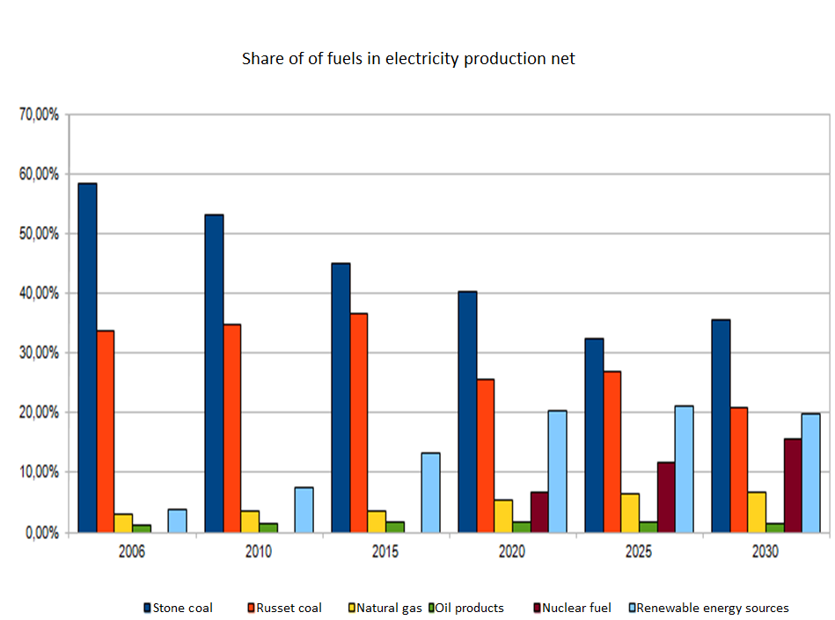

Slide 8
How does it work?
The energy of electromagnetic radiation causes knocking out the electrons from semiconductors at the solar cell (in photovoltaic cells there are two semiconductors made of ciliceous plates). When there is a lack of electrons in one semicodutor (the effect of knocking out caused by radiation), they are cumulated in the second semiconductor. At the butt of two semiconductors there is so called dam, minus by the first and plus by the second semiconductor. As the result of insolating of solar cell with solar radiation, the photons cause the moving of particles in the semiconductors. Finally the tension, in other words the electricity, is produced.

Slide 9
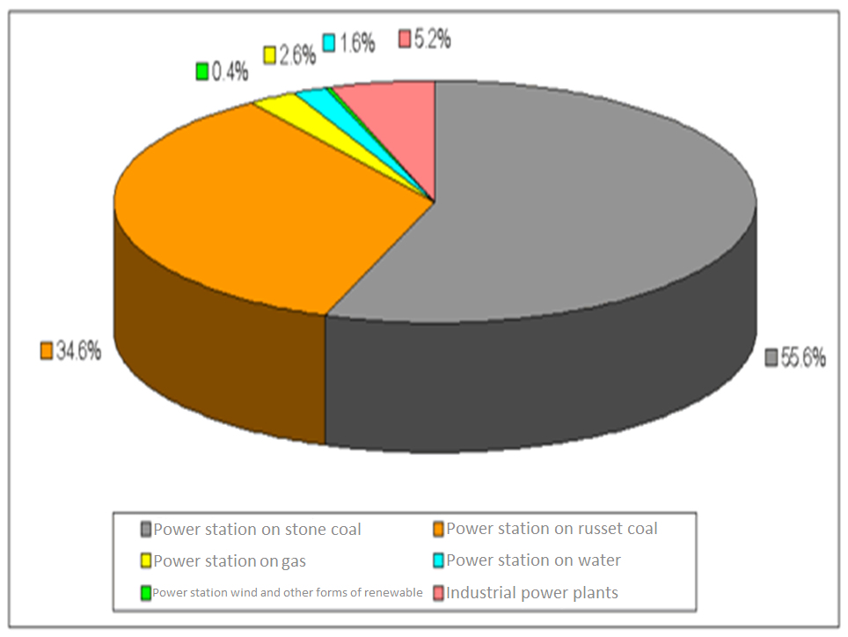

Slide 10
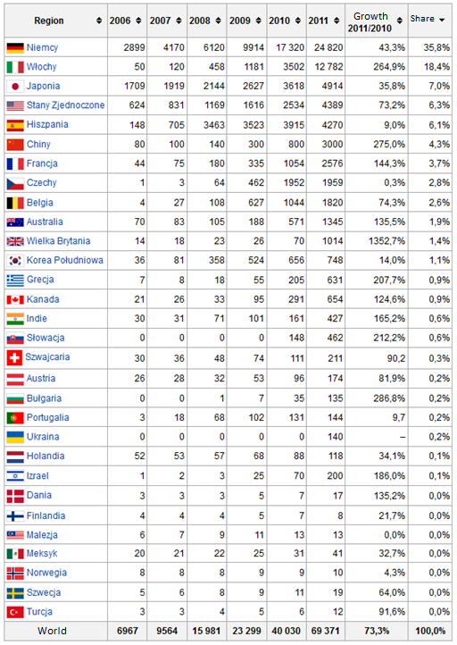
The table shows the total power of photovoltaic cells in the various countries in MW

Slide 11
Curiosities
In 1981 solar plane Solar Challenger flew over British Channel using only solar energy. The wings of the plane were covered with solar batteries which supplied electric engine.
In Florida, The USA, public phones are supplied by solar batteries installed on the roofs above them.
Focusing of the solar radiation is used in furnaces. Curved concentrator focuses solar beams on products. Some furnaces instead of curved reflector use flat reflectors placed at the right angle.

Slide 12
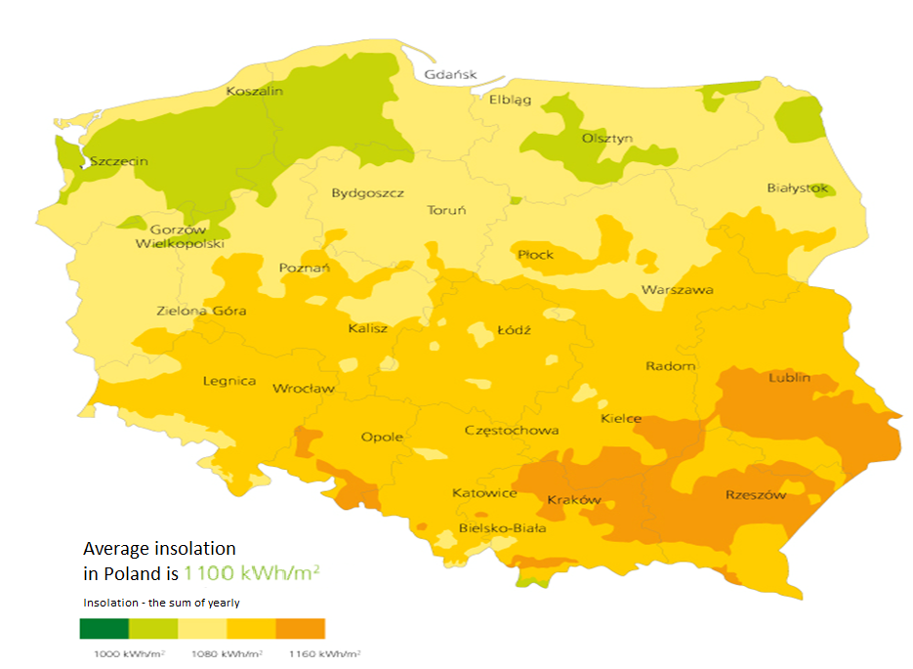

Slide 13
The end
Thank you for watching the presentation.
Prepared by Patryk Skrzypacz
Ip
20.02.2013r.

Slide 14
Sources
http://pl.wikipedia.org/wiki/Energetyka_s%C5%82oneczna
http://www.solarid.pl/
http://www.sciaga.pl/tekst/54377-55-rola_energii_slonecznej_na_ziemi
http://www.google.pl/search?um=1&hl=pl&q=kolektor%20s%C5%82oneczny%20budowa

